Slide 1



Implementing LD 2003 (PL 2021, Ch. 672) Rules:
Zoning Ordinance Amendments
“An Act To Implement the Recommendations of the Commission To Increase Housing Opportunities in Maine by Studying Zoning and Land Use Restrictions”
Freeport Town Council Meeting 01/23/24

Slide 2
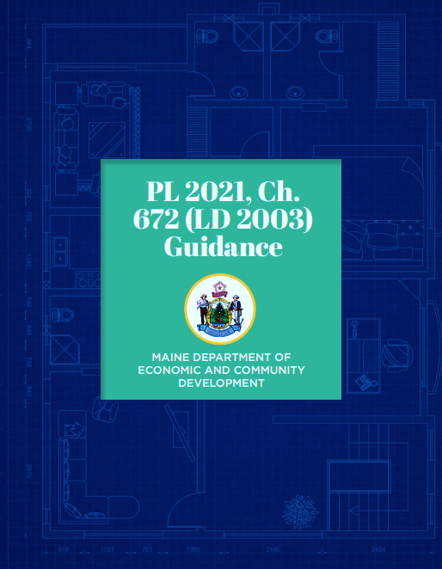
Overview LD 2003
The Municipal Role in Fair Housing and Statewide Housing Production
Clarifies that municipalities can regulate short-term rentals
The Affordable Housing Density Bonus
The Extra Dwelling Units Allowance
The Accessory Dwelling Units (ADUs) Allowance
Notes:
Not going into details- just a reminder that this is a continuation from last meeting and that the changes to the ordinances relate to these rules.

Slide 3
Municipalities still have power to:
ENFORCE
  Shoreland zoning ordinances
  Water and wastewater requirements
  Subdivision requirements
REGULATE
  Conduct site plan review, if required
  Dimensional requirements (setbacks, height, lot coverage)
  How many square feet of land are needed for each dwelling unit (other than ADUs)
  Establish the maximum size of ADUs
In addition, private covenants/deed restrictions are still valid
Notes:
Reminder that these are things the town can still control.

Slide 4
Affordable Housing Density Bonus - Amendments
30-A MRS 4364
Amended Section 104. Definitions, including a new use category: “Affordable Housing Development”
Adding Affordable Housing Development to the list of zoning districts that allow multifamily housing
New Section 536. Affordable Housing Development Density Bonus
Eligible for 2.5 density bonus
Eligible for reduced parking requirement - no more than 2 parking spaces for every 3 units
Applicable to zoning districts that: allow multifamily and is the Designated Growth Area or served by water and sewer*
2.5
Notes:
* Served by water and sewer also includes comparable sewer system that may be privately owned.

Slide 5
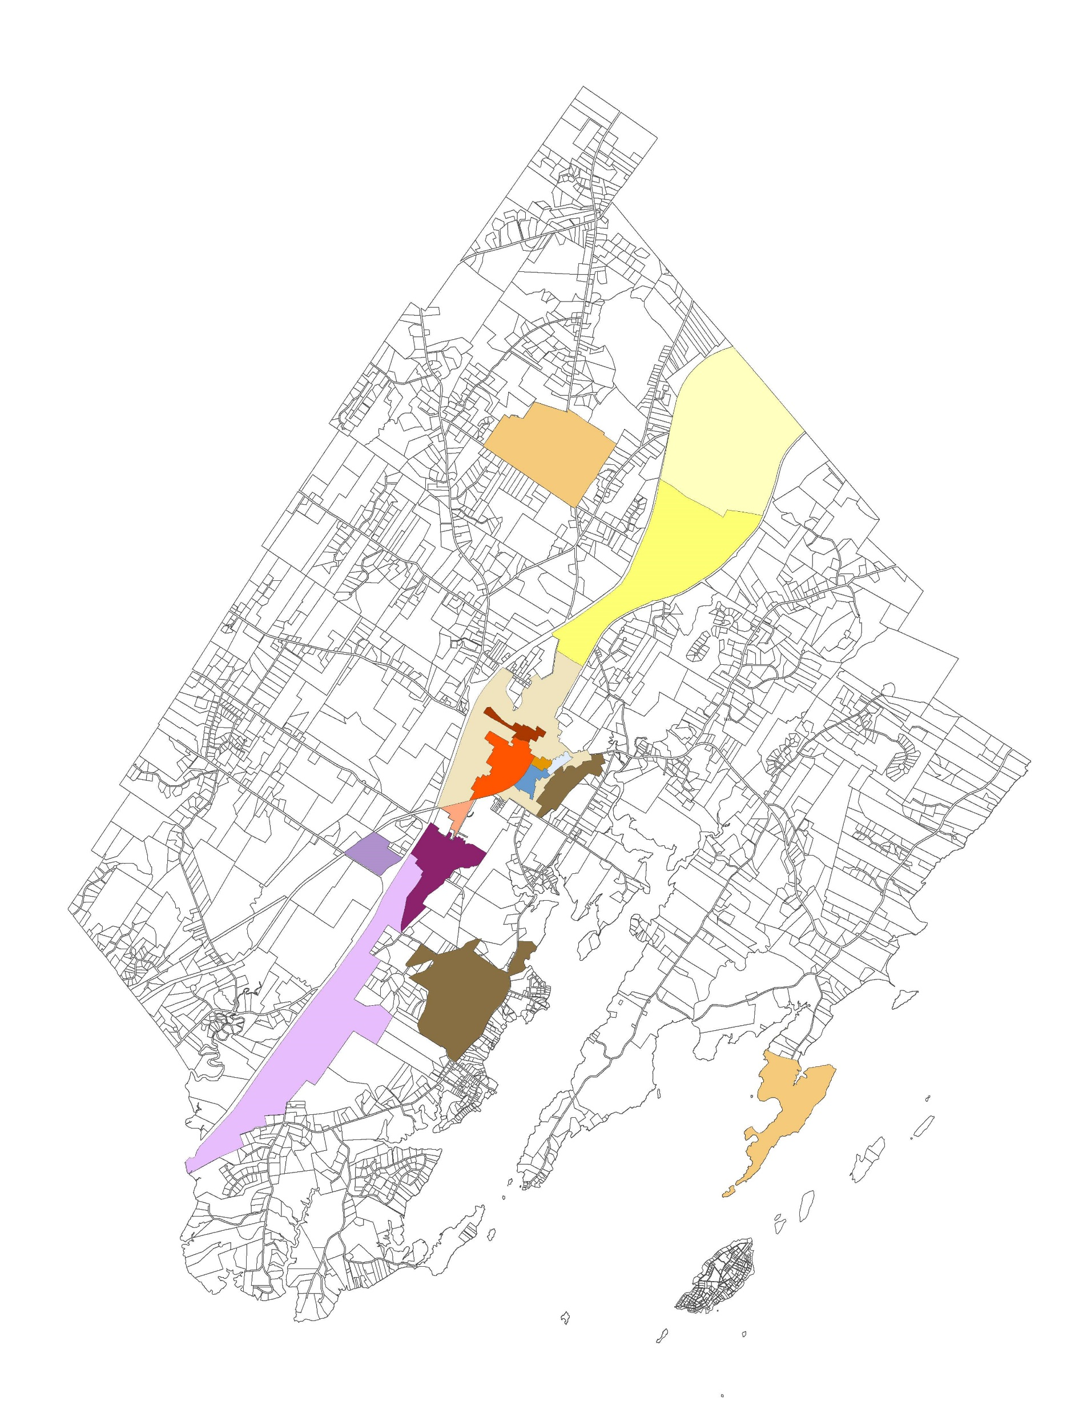
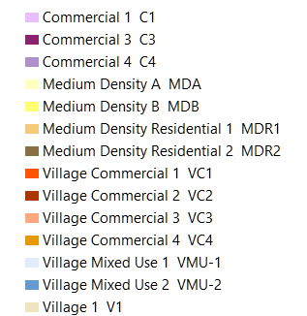
Multifamily Districts
List of zoning districts that allow multifamily developments. Please note multifamily allowed, subject to conditions outlined in each zoning district section

Slide 6
Extra Dwelling Units Allowance
30-A MRS 4364-A Residential areas, generally; up to 4 dwelling units allowed
  Applicable to all zoning districts that allow residential uses
  A lot may have 4 units if it is in the Designated Growth Area*
Designated Growth Areas
  A lot may have up to 3 units if is outside of the Designated Growth Area*
Not in the Designated Growth Areas
  *The Planning Board’s recommendation is to allow property owners to build up to the maximum number of units allowed over time. This is more permissive than the State’s minimal requirements.
Notes:
Note that we added new potable water standards for PFAS that will apply to any new unit

Slide 7
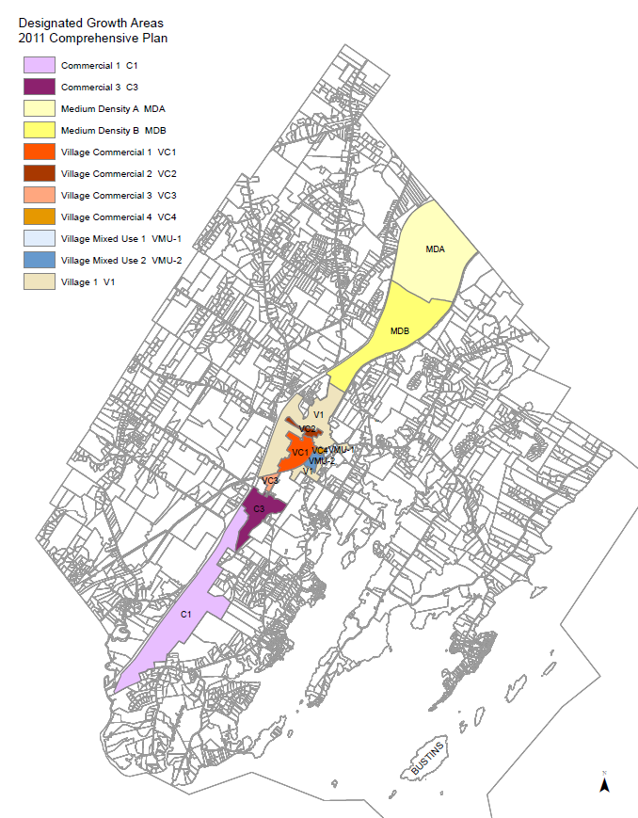
Map of Designated Growth Areas
Based on the 2011 Comprehensive Plan

Slide 8
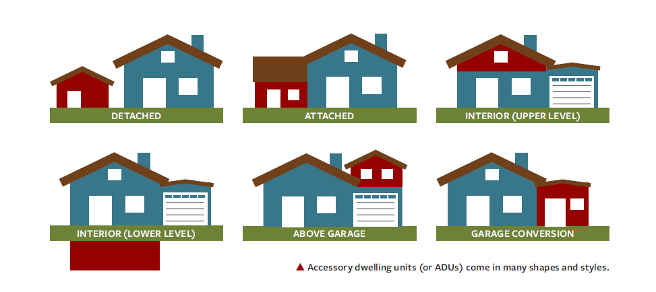
Accessory Dwelling Units (ADUs) Allowance -
30-A MRS 4364-B Accessory dwelling units
Allow ADUs in lots containing a duplex or two single-family homes
Increase the maximum size to 75% up to 1,100 sq ft
Remove parking requirements
Remove limitations on number of bedrooms
Remove owner-occupancy requirement
Removing certain aesthetic requirements
Remove the requirement that makes it so detached ADUs need to be within 50 feet of the house
Remove the condition that ADUs can only be built in the shoreland zone if it is connected to public water and sewer
30-A MRS 4364-B Accessory dwelling units

Slide 9
Questions?

Slide 10
Chapter 25 Subdivision Ordinance Amendments
Freeport Town Council Meeting 01/16/24

Slide 11
Chapter 25 Subdivision Ordinance Amendments
Related to Implementing State LD 2003 (PL 2021, Ch. 672) Rules and
Review Criteria (M.R.S. 30-A §4404)
  Amended definitions for consistency with the Zoning Ordinance
  Added submission requirements for Affordable Housing Developments
  Incorporated approval standards related to the State’s review criteria under M.R.S. 30-A §4404
  General clean-up (references, etc.)

Slide 12
Chapter 25 Subdivision Ordinance Amendments
Related to Implementing State LD 2003 (PL 2021, Ch. 672) Rules and
Review Criteria (M.R.S. 30-A §4404)
  Amended definitions for consistency with the Zoning Ordinance
  Added submission requirements for Affordable Housing Developments
  Incorporated approval standards related to the State’s review criteria under M.R.S. 30-A §4404
  General clean-up (references, etc.)
Farmland
Timber Harvesting

Slide 13
Questions?

Slide 14
Implementing LD 2003 (PL 2021, Ch. 672) Rules: Chapter 65 Shoreland Zoning Ordinance Amendments
Amended definitions for consistency with the Zoning Ordinance
No additional changes needed

Slide 15
Questions?

