Slide 1
Managing Browntail Moth Euproctis chrysorrhoea (L.)
Hughes Inc.
Arbor & Land Management
Sensible Arboriculture Since 1986
Prioritizing Treatment Strategies

Slide 2
BTM: What, When, Where, How
What: A leaf-feeding, tree defoliating caterpillar equipped with toxic hairs. Especially attracted to fruit trees, rose & oak.
When: Accidentally introduced in 1897 to MA. By 1913 had spread to all NE.
Where: Currently limited to coastal areas in ME, but moving inland.
How: Produce one generation per year. Spread by moth flight as well as strong wind.

Slide 3
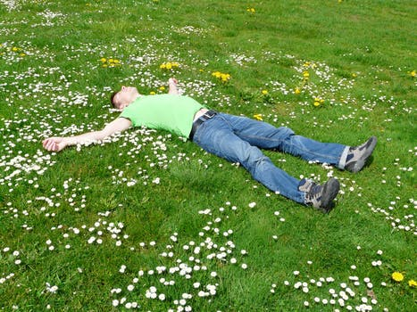
BTM: Matching Site to Strategy
Tier 1 Locations: Sites of higher housing volume such as town homes, and/or where people come to walk, sit, or meet such as parks. (Higher Occupancy Rate)
Tier 2 Locations: Sites of lower housing volume such as residential streets, and/or where people are passing through in fewer numbers, or in cars or on bikes. (Lower Occupancy Rate)

Slide 4
BTM: Management Options
Pruning: Involves removal of larval-infested webs before they become active in April.
Spraying: Hydraulic (with hose) or Air-driven
Root Injection: Similar to root fertilization.
Trunk injection: Pressurized into trunk base.

Slide 5
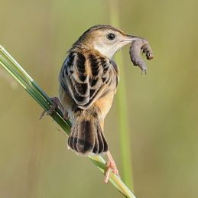
BTM: Management Options Pro’s and Con’s
Pruning:
Pro- Possible to remove 100% of pest
Con- Cost-effect only on small trees
Spraying:
Pro- Generally less expensive and can be targeted to early stage of BTM exposure.
Con- Off-target residue is hard to control.
Root Injection:
Pro- Less expensive and provides longer-term residual
Con- Can impact other caterpillars due to being longer-term residual
Trunk Injection:
Pro- Cleanest approach (closed system) with longer-term residual (up to 2-years)
Con- Most expensive. Can impact other caterpillars due to being longer-term residual
All treatments should be done as early as possible to kill pest at its smallest size, thus reducing toxic hairs remaining on site.

Slide 6
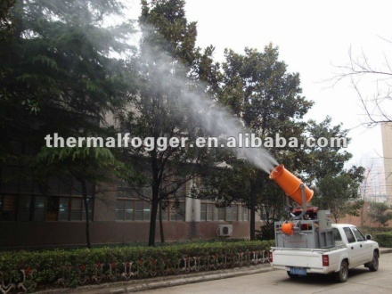
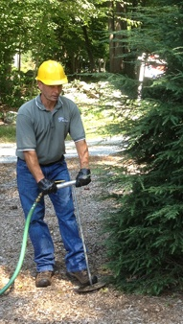
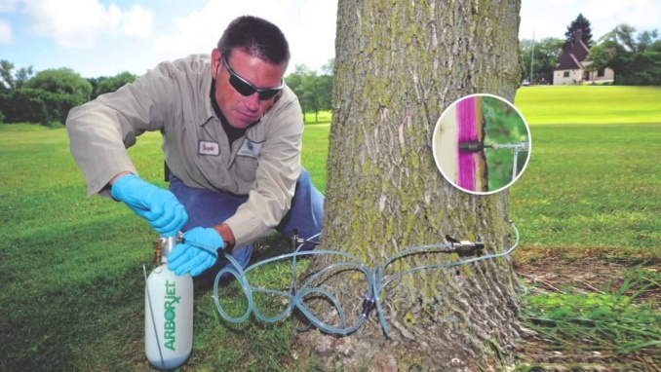
BTM: Treatment Methods
Spraying
Root Injection
Trunk Injection

Slide 7
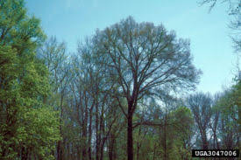
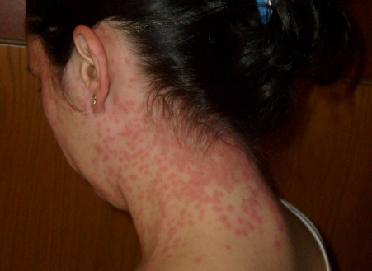
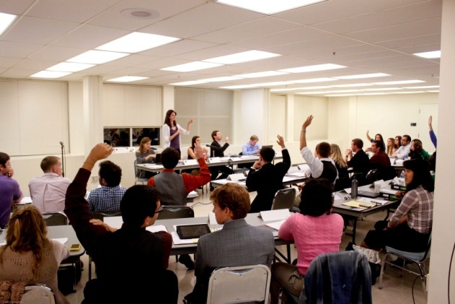
BTM: Considerations
Weakened/Defoliated Trees
Public Health
Community Input/Awareness

Slide 8
BTM: FAQ’s
How long will I have to treat this pest?
Does it make sense to just remove the oaks from my property?
What good does treating my trees do if the insect can migrate from the property next door which does not treat?
How many time can an oak tree be defoliated before it suffers decline or death?

