Slide 1
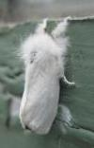
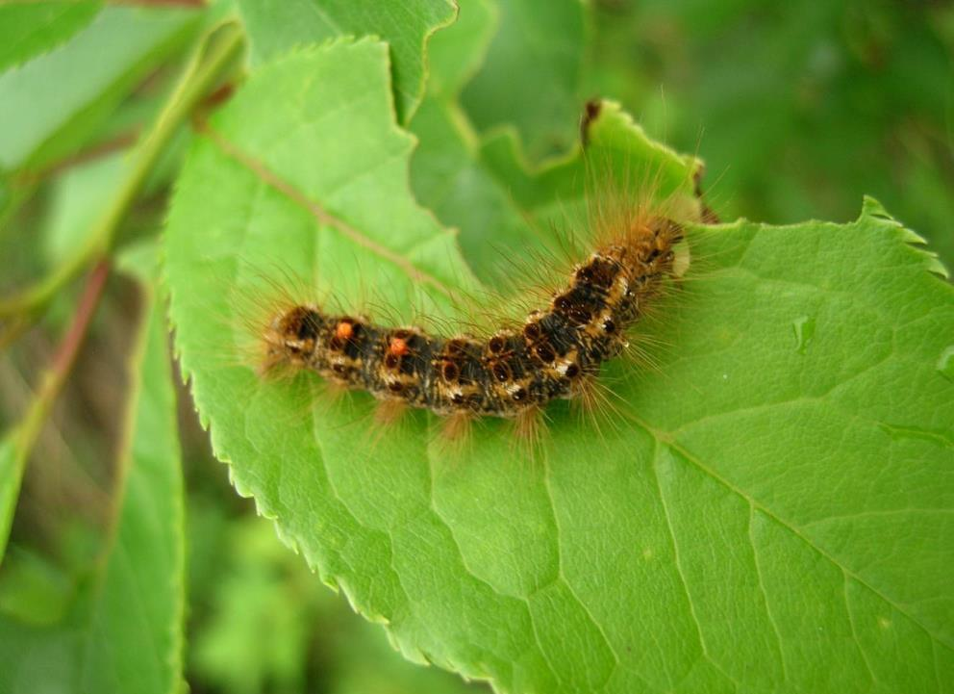
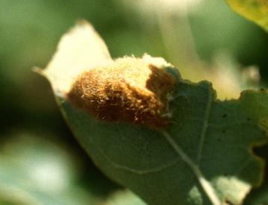
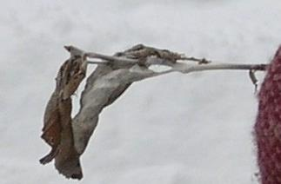
Browntail Moth Background
Allison Kanoti Acting State Entomologist Maine Forest Service
Department of Agriculture, Conservation and Forestry

Slide 2
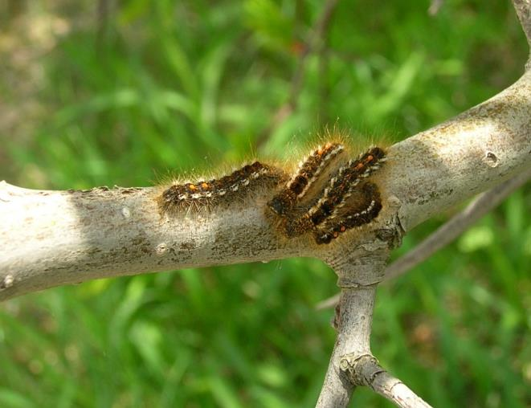
What is Browntail Moth?
An invasive moth originally from Europe
Likely introduced on live plants to Somerville, MA (early 1900’s). Established in Maine since 1904.
Feeds on a wide range of hosts, favors rosaceae (apples, pears, roses) and oaks, but also other hardwood

Slide 3
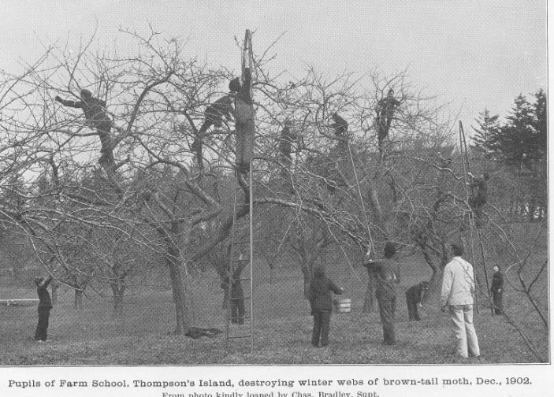
Browntail Moth - History
Extensive efforts were made during the early 1900’s to control BTM:
Winter webs clipped and burned by the 10,000's
Spray projects initiated
Apple trees cut down
A federal quarantine imposed
A huge biological control program instituted
Parasitoids & predators released

Slide 4
Browntail Moth - History
The Browntail Moth population collapsed in the 1920s
Possibly due to a combination of weather and a fungus, Entomophaga aulicae and fly parasitoids
Infected browntail moth caterpillar

Slide 5
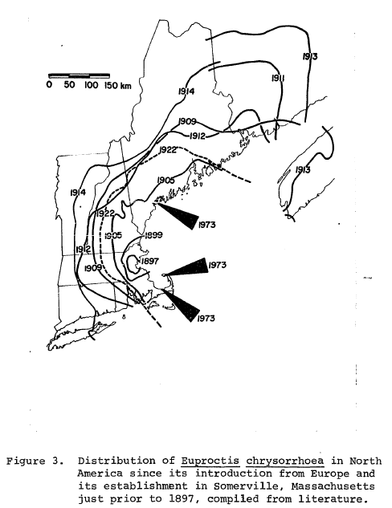
Browntail Moth - History
Population retreated to:
a few islands in Casco Bay, ME, and
Cape Cod, MA
Occasional outbreaks over next 60+ years
Map From P. W. Schaefer, 1974
PhD Dissertation
Population Ecology of the Browntail Moth (Euproctis Chrysorrhoea L.) (Lepidoptera: Lymantriidae) in North America

Slide 6
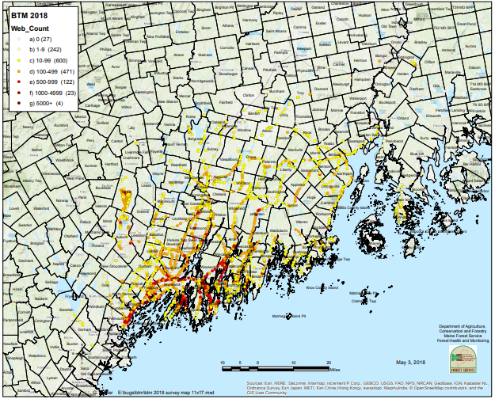

Slide 7
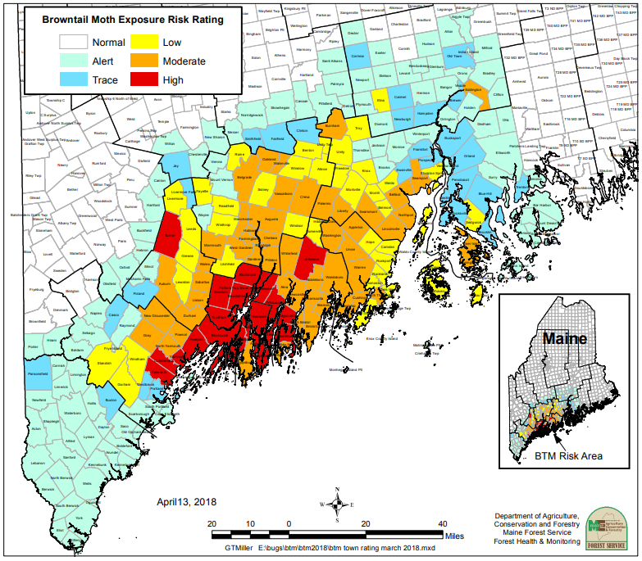

Slide 9
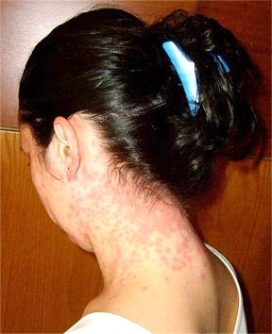
The Problem: Hairs
Human nuisance
Risk to Human Health: Toxic Hairs on caterpillars & cocoons

Slide 10
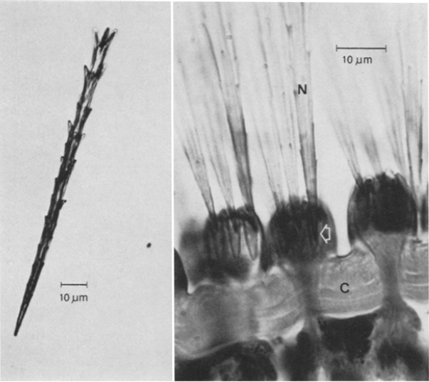
Browntail Moth - Toxic hairs
Tiny hairs from caterpillars (0.15 mm (0.005 inch) long) are like hypodermic needles that inject toxins into skin and lungs.
Carried in air, settle on grass, leaves, brush, in yards, on porches, under boats, etc.
Can become air-borne again
Toxins last 1-3 years in environment.
Notes:
Toxins are mostly histamines and enzymes. Our bodies produce histamines as an immune or allergy response. These histamines cause a rash and can cause

Slide 11
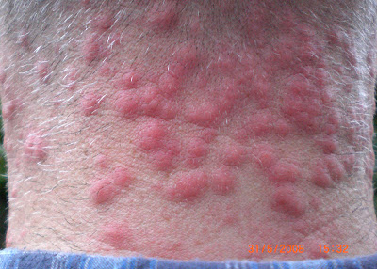
Browntail Moth Rash
Contact dermatitis
Most common in late June/July
Can develop immediately or after a few hours
Rash lasts hours to days
Treatment focused on relieving symptoms

Slide 12
Secondary problem: tree damage
Caterpillar feeding causes
branch dieback (>30% defoliation)
tree mortality (only after multiple years of severe defoliation and/or other stress factors)
Common on residential shade trees, ornamental trees, orchards
Oak, apple, cherry, etc.

Slide 13
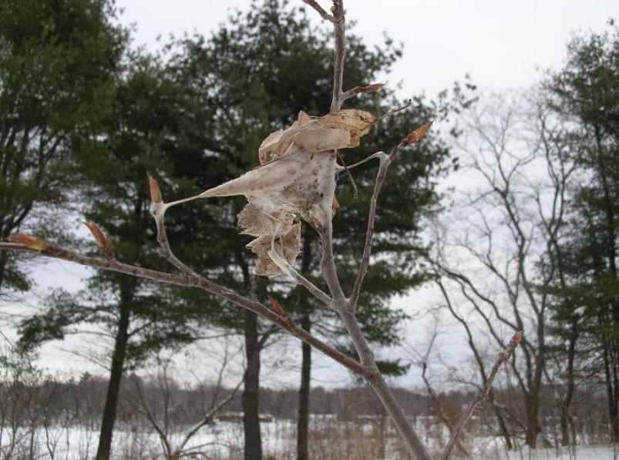
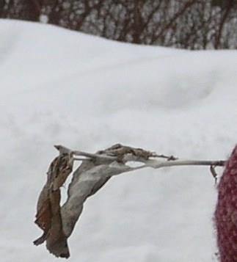
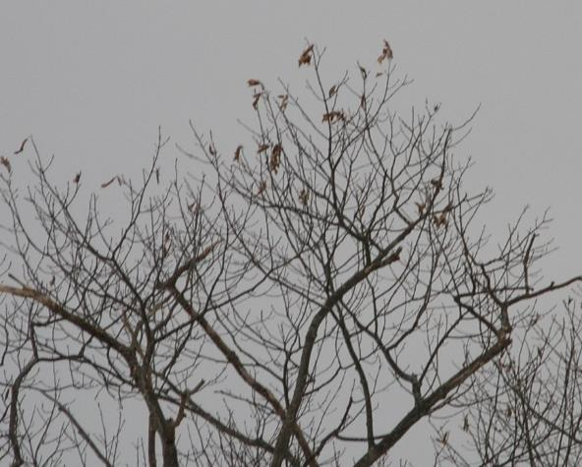
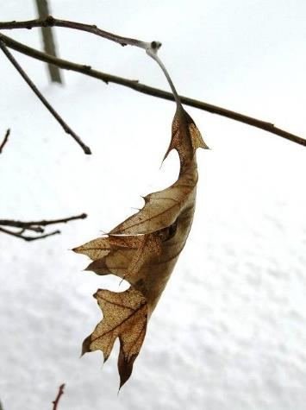
Browntail Moth - Life Cycle
Spend winter in webs as 2nd, 3rd or 4th instars
25-400 caterpillars/web

Slide 14
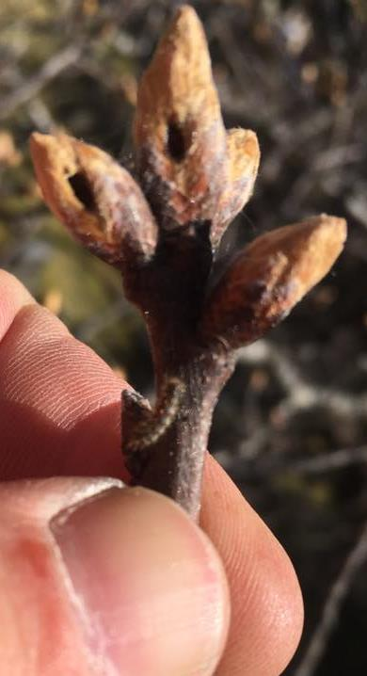
Browntail Moth – Life Cycle
Caterpillars emerge in late April and May
Wander beginning late May
Feed on foliage until late June
Molt three to five times
Cast skins have toxic hairs on them
Photo: Bath, ME Division of Forestry, Facebook

Slide 15
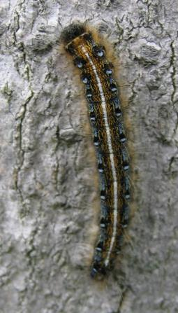
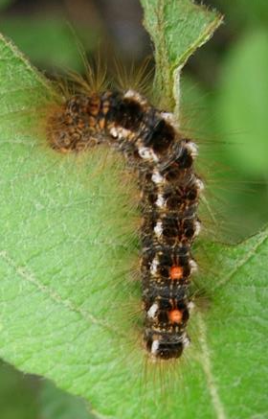
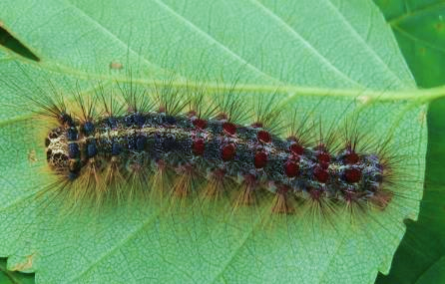
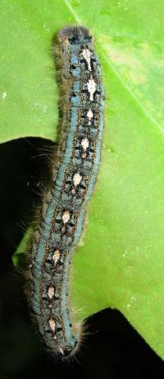
Tent-makers
No Tents
Browntail Moth | Eastern Tent | Forest Tent | Gypsy Moth
Look for Overall brown color; White tufts along sides; Red-orange dots on tail-end DANGER!! | Look for White stripe down center of back Blue spots like the “eye” in peacock feather along each side of stripe | Look for White or off-white footprint-shaped marks down the center of the back Blue body coloration in later instars | Look for Prominent knobs with hairs on each side of head capsule. Five pairs of blue- and six pairs of red- spots along back (4th instar and later).
Invasive Human & Forest Health Impacts | Native Mostly aesthetic impacts | Native Occasional outbreaks | Invasive Forest Health Impacts Quarantined pest

Slide 16
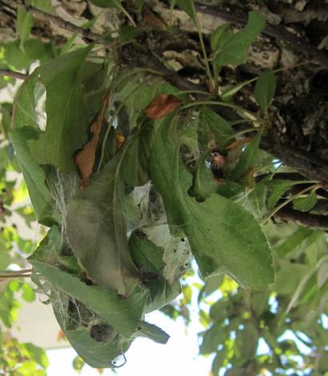
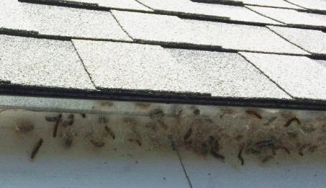
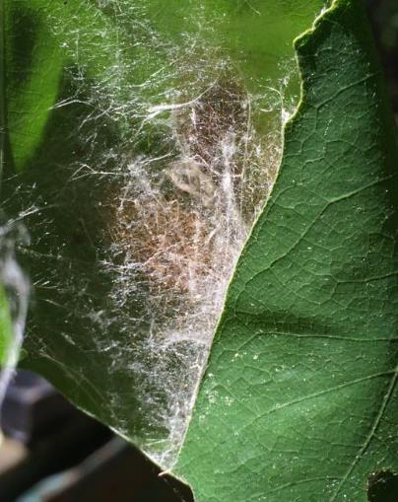
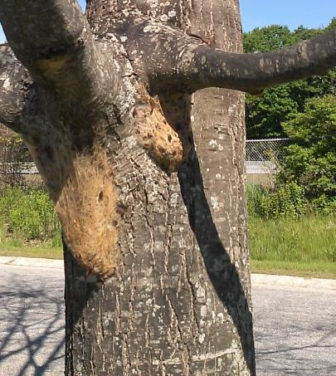
Browntail Moth - Life Cycle
In late June – early July
Caterpillars move around looking for a good place to spin a cocoon and pupate
They make cocoons in leaves, on branches, on buildings, under eaves and boats
Cocoons are full of toxic hairs!
Photo: Midcoast Maine Browntail Moth Support Facebook

Slide 17
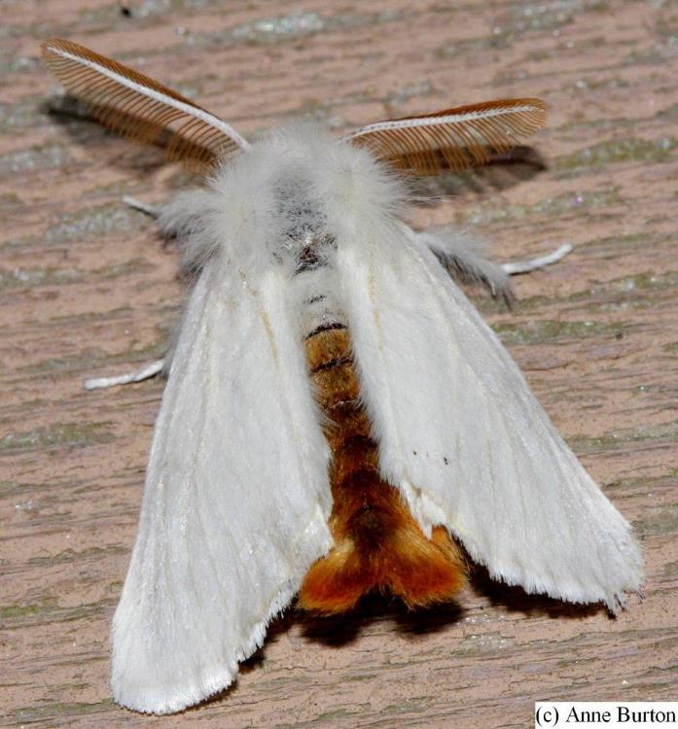
Browntail Moth - Life Cycle
Moths emerge from cocoons in July
Attracted to lights (flight activity peaks b/w 10pm and Midnight, moths at lights heavily weighted to males)
Deposit eggs on host leaves.

Slide 18
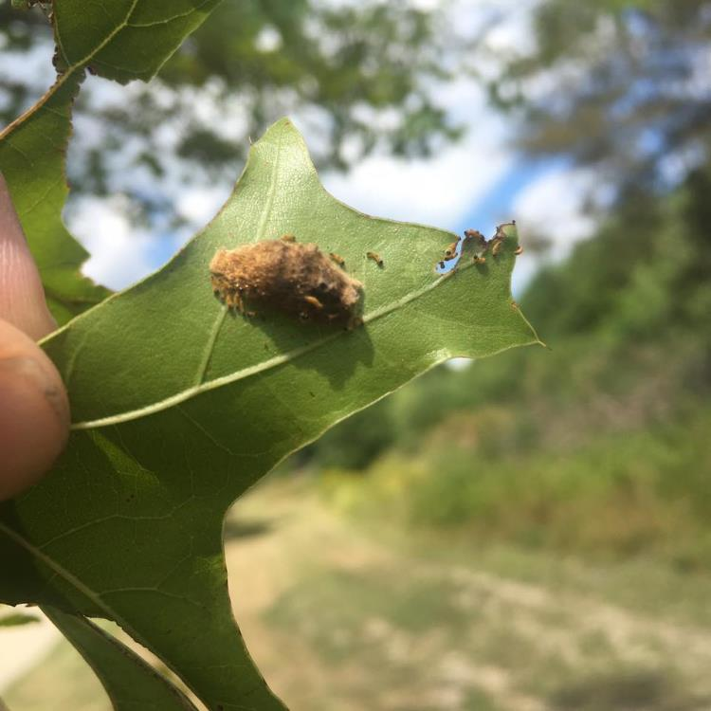
Browntail Moth Life Cycle
In July (Mid-Late) Eggs are deposited on leaves of host trees
Oak, birch, apple other hardwoods & shrubs
200-400 eggs
Covered hairs from female’s abdomen
Prefer non-current-year-defoliated
Eggs hatch in August
Photo: Bath, ME Division of Forestry, Facebook

Slide 19
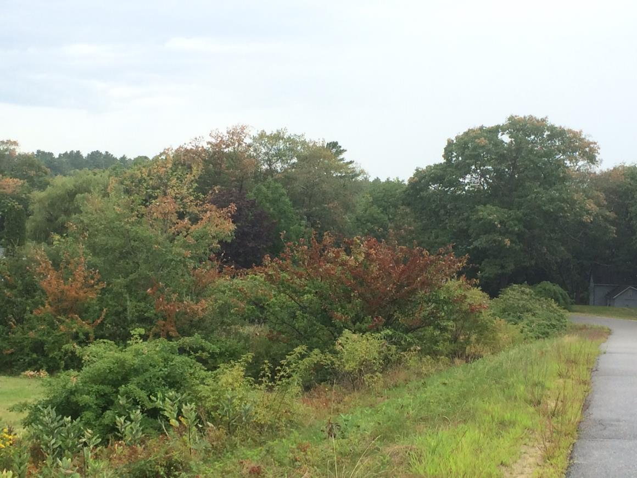
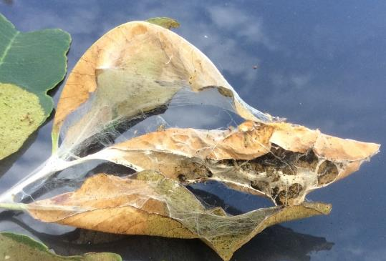
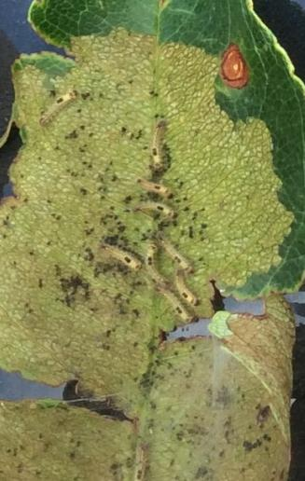
Browntail Moth - Life Cycle
Caterpillars skeletonize leaves and tie leaves together and to twig with silk

Slide 20
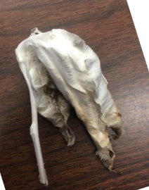
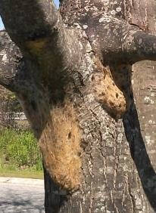
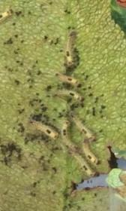
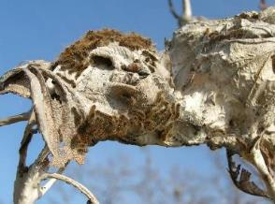
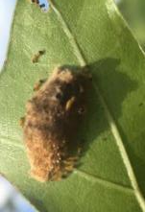
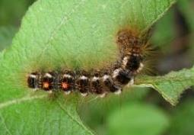
Personal Protection Precautions
Survey, Clip and Destroy Webs, Line up Insecticide Treatment
Insecticide Treatment BEFORE June,
Personal Protection Precautions
Personal Protection Precautions, Limit Outdoor Lights
Insecticide Treatment
(Newer Approach)
Winter Webs
Feeding Larvae
Adults
Sept-April
April-June
Pupae
June-July
July-Aug
Eggs
July-Aug
Feeding Larvae
Aug-Sept
Highest Exposure Risk for Hairs*
Toxin in hairs is extremely stable (3+ yr); exposure most likely in dry conditions. In infested areas use PPP whenever conducting activities that might stir up hairs.
*
Photos by MFS except: Adult: Anne Burton, Egg mass: Bath Division of Forestry

Slide 21
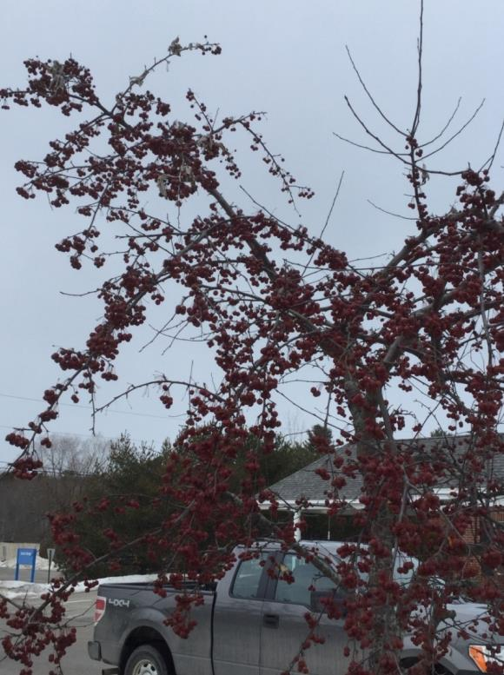
Control: don’t move BTM
When traveling late May-July to BTM infested areas:
DO NOT PARK under/near infested ornamental/street trees!
New infestations anecdotally tied to locations with high populations (E.g. Eddington, Old Town, Burnham)
CHECK that you are not moving larvae, cocoons, moths

Slide 22
Precautions & Personal Protection: Avoid Exposure to BTM Hairs
Summer: June through August – in areas where a BTM population is known/suspected:
Avoid exposure to hairs – personal protection is key
Avoid places heavily infested by caterpillars.
Dry laundry inside to avoid having the clothing become impregnated with toxic hairs.

Slide 23
Browntail Moth - Precautions
Year round - in infested areas
Use caution cleaning debris left by caterpillars because the toxin is extremely stable and remains a hazard for a number of years.
Gardening
Brush removal, chipping
Opening camp or cottages

Slide 24
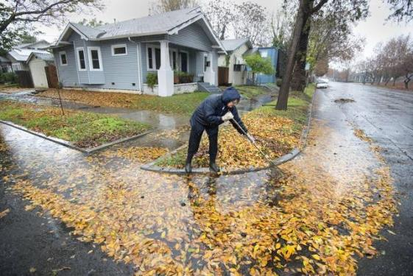
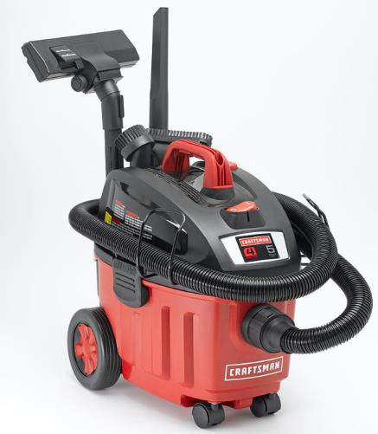
Working Outdoors in Known Infested Areas
Wet down area with a hose or work on a damp day as moisture helps keep the hairs from becoming airborne there by minimizing contact.
Use a HEPA vacuum to remove browntail moth caterpillars from buildings, driveways, equipment.

Slide 25
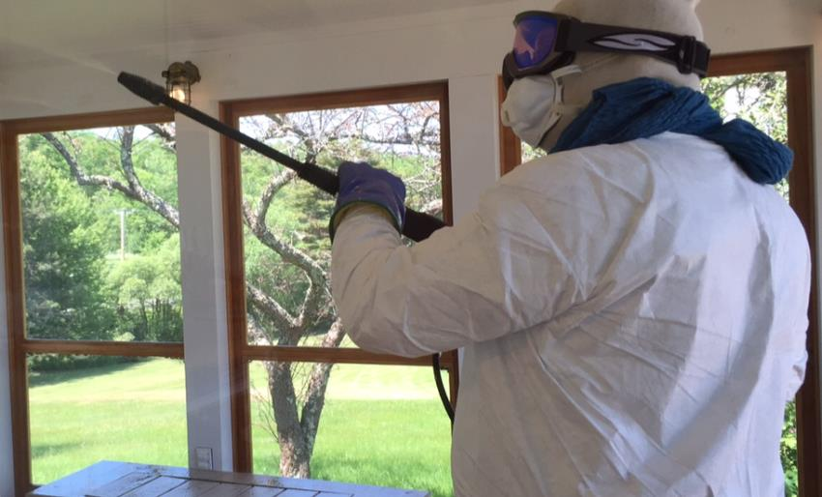
Browntail Moth - Precautions
When doing things that stir up caterpillar hairs wear Personal Protective Equipment:
Coveralls - tightly closed at neck, wrists and ankles
Respirator and goggles
Head covering and gloves
Pre-contact poison ivy
wipes may help
Sarah Devlin, Bangor Daily News
Notes:
N-95 respirator or dust mask filters 95% of airborne particles. Hairs are about 15 x larger than average dust particle so a well fitting dust mask should work. Get the kind with metal on nose. Wont fit well over a beard though.

Slide 26
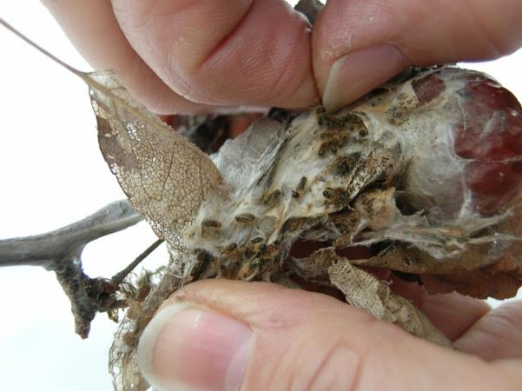
How can Browntail Moth be Managed?
Cold winter temperatures do NOT kill browntail moth
Wet, cool springs when populations are high allow diseases to kill caterpillars
Fungus
Virus
Other natural enemies not effective at high populations

Slide 27
Reduce Browntail Moth Populations in Winter
Winter webs are pruned
Remove, burn or soak in soapy water
Risk of contact with hairs is low (use gloves)
DESTROY the webs
BEFORE mid-April
List of arborists willing to do this work available from Maine Forest Service (287-2431).

Slide 28
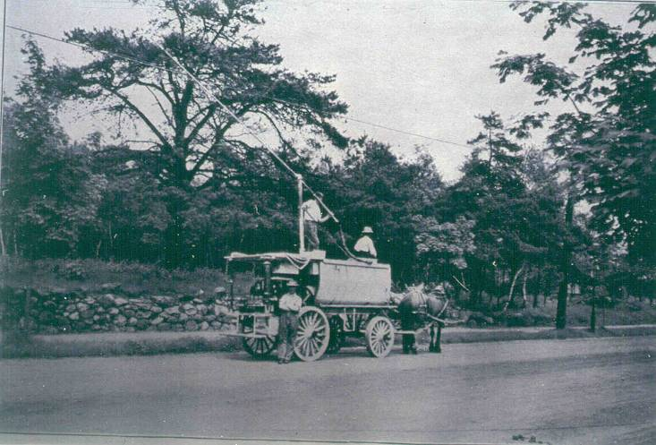
Chemical control of larvae
Chemical control in the spring – BEFORE the end of May
Later spraying does not reduce exposure to hairs
Hire a licensed pesticide applicator
More effective if control is widespread
List of arborists willing to do this work available from Maine Forest Service (287-2431).

Slide 29
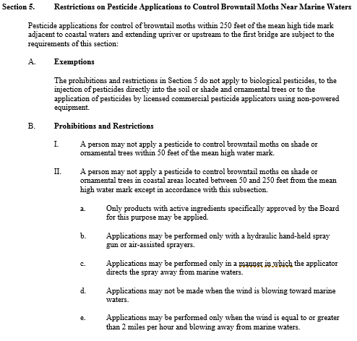
BPC Chapter 29 Rules Sec 5

Slide 30
Questions?

Slide 31
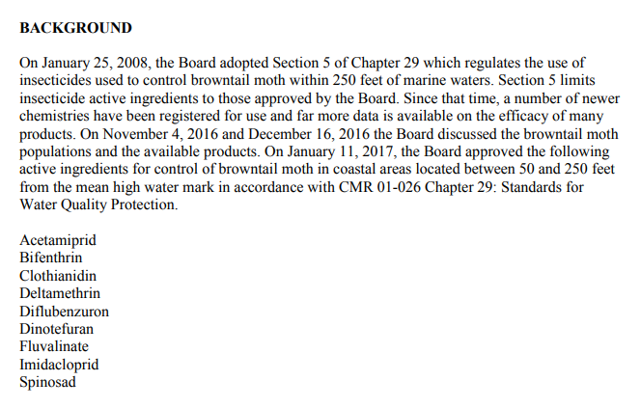
Products Allowed in 50-250’ of Marine Waters/ Definition of Biological Pesticide

